Slide 1
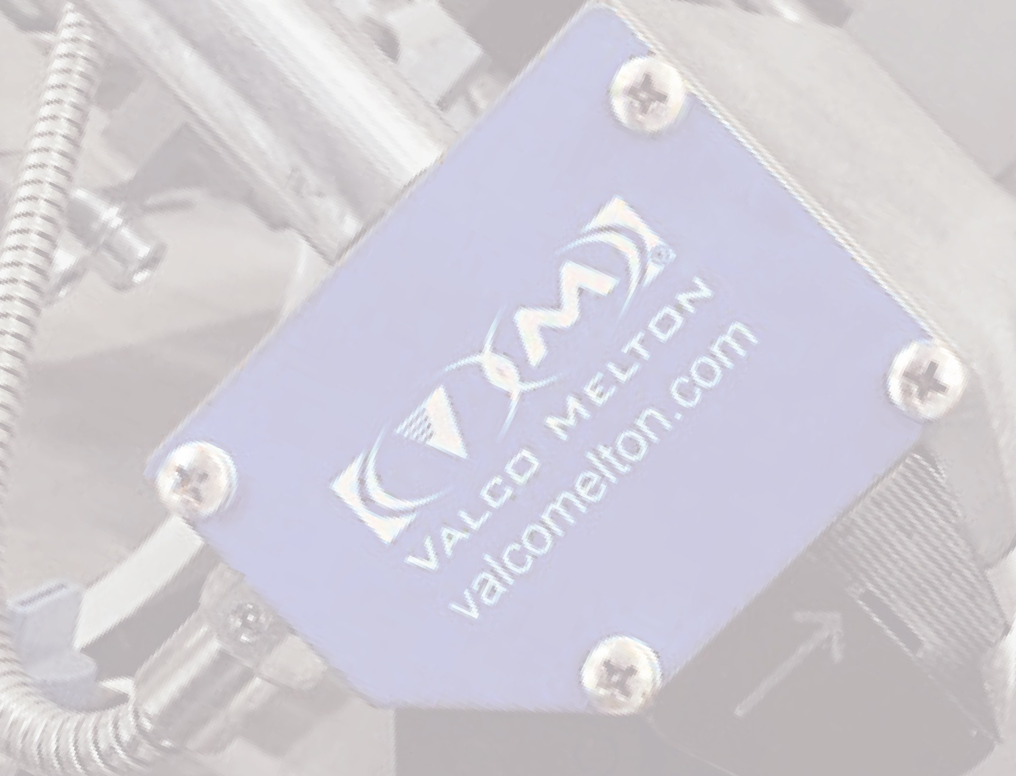

Slide 2
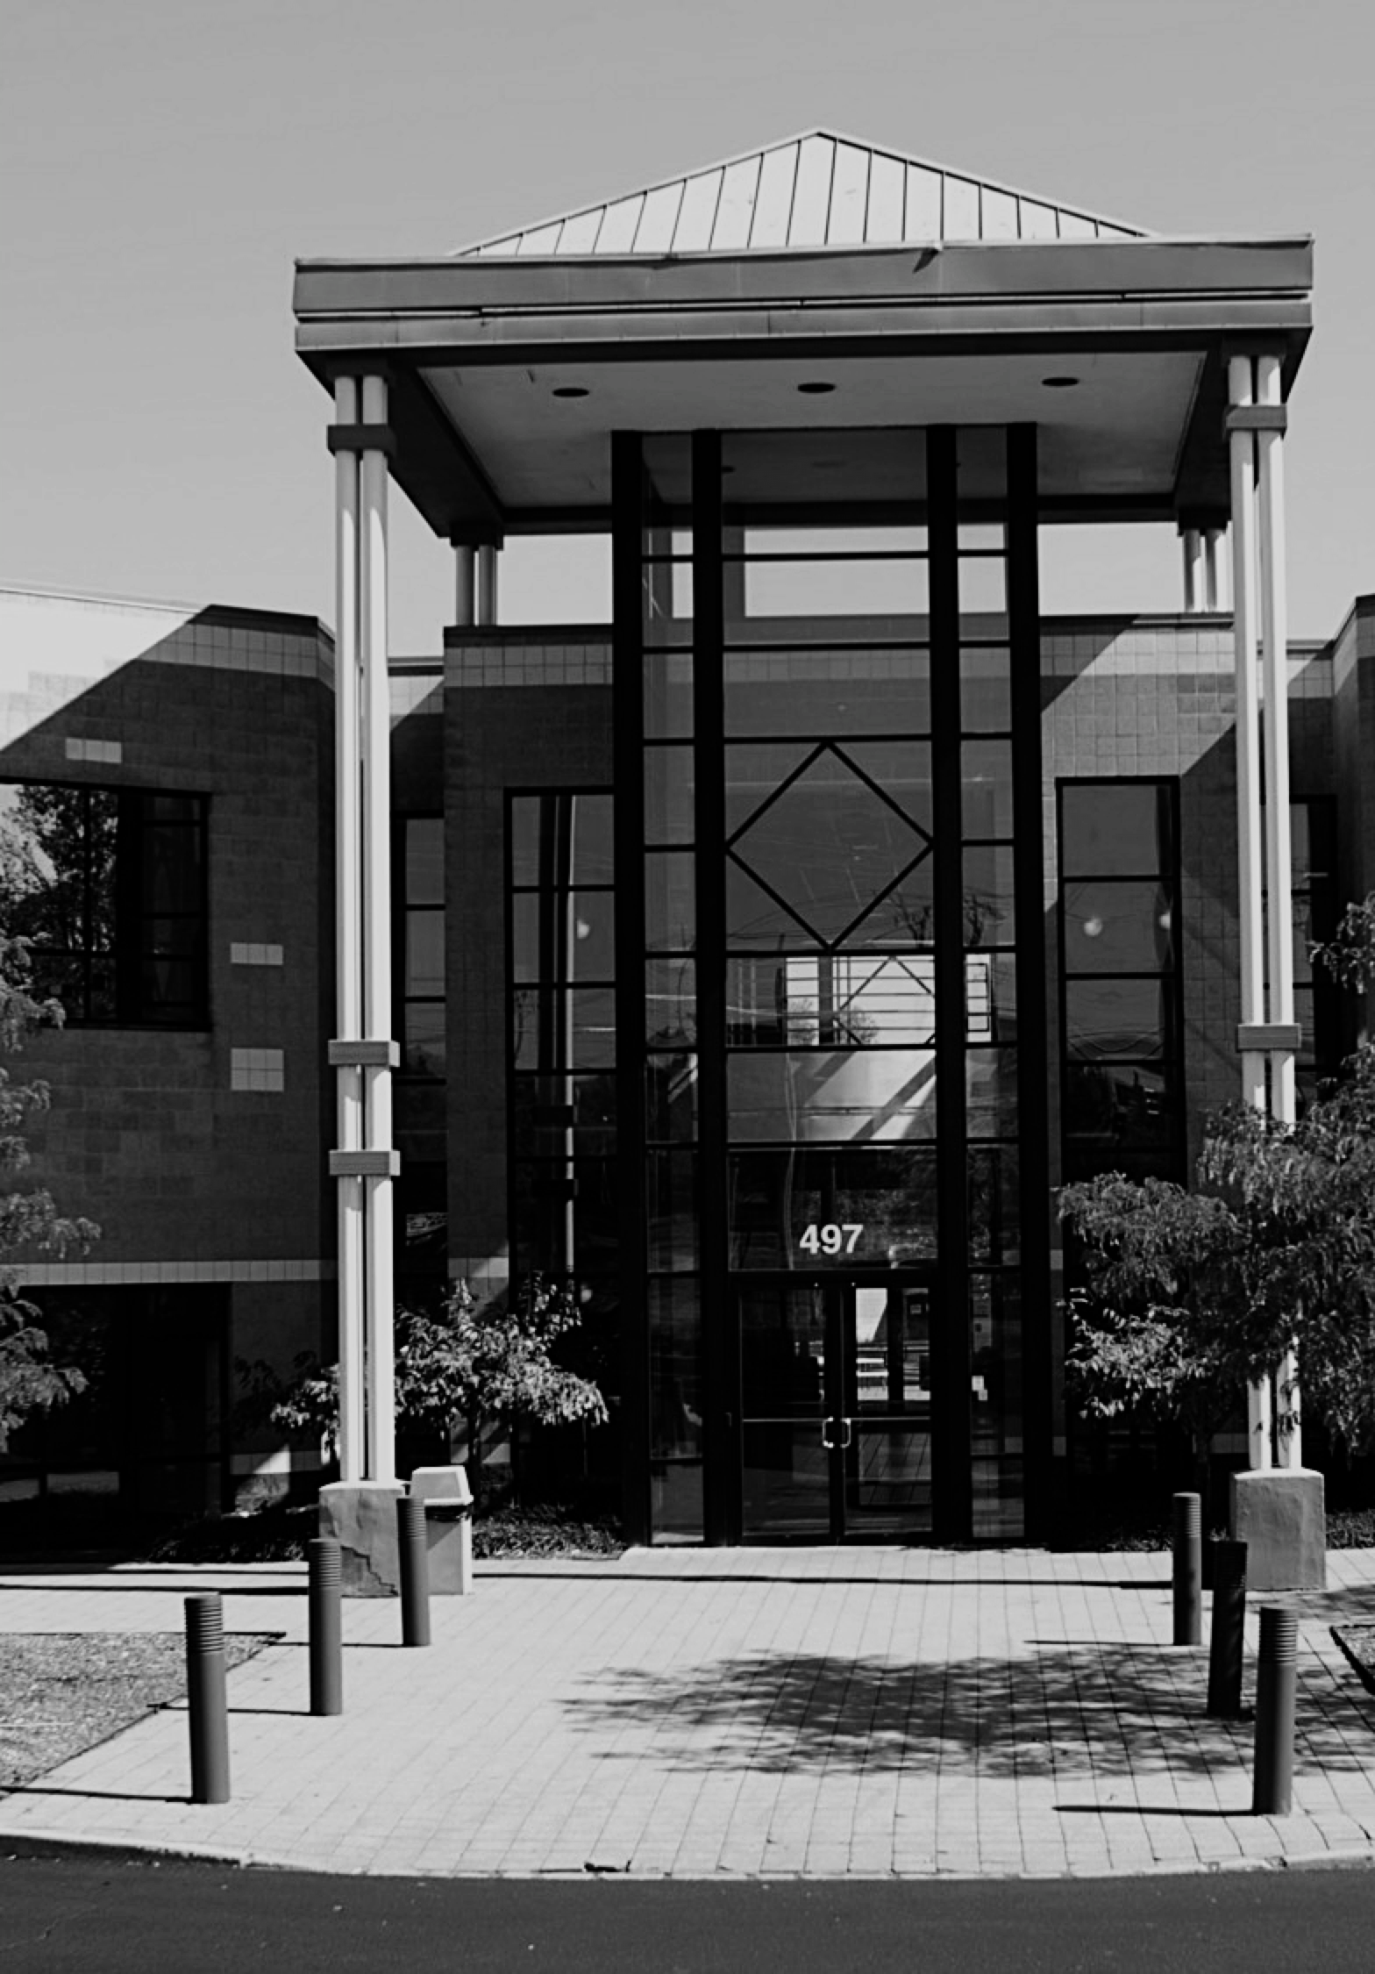
Precision dispensing and quality assurance systems for over 60 years
Valco Melton is present all over the world to offer the best local service

Slide 3
67 YEARS
OF HISTORY

Slide 5
67 YEARS
OF HISTORY
VALCO MELTON
IN NUMBERS

Slide 6
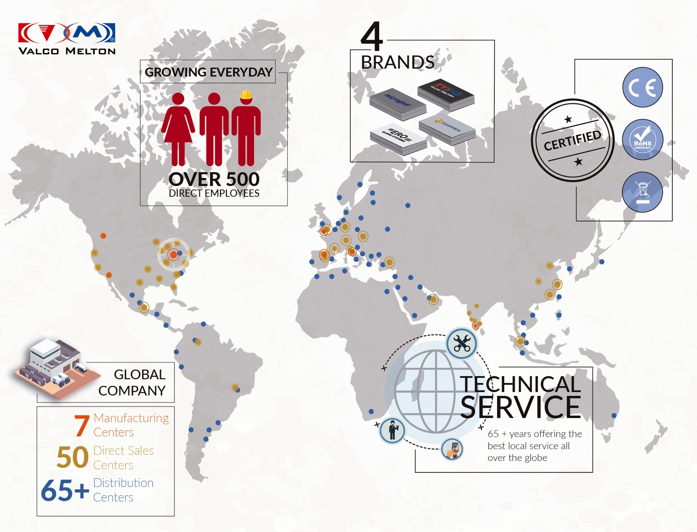

Slide 7
67 YEARS
OF HISTORY
VALCO MELTON
IN NUMBERS
WHAT
WE DO

Slide 9
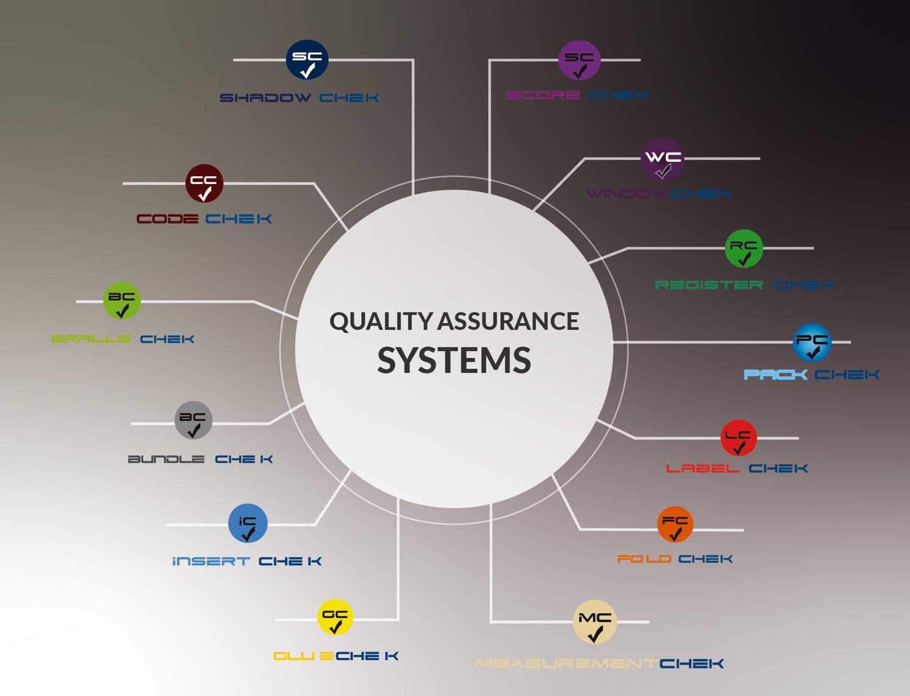

Slide 10
67 YEARS
OF HISTORY
VALCO MELTON
IN NUMBERS
WHAT
WE DO
WHERE
WE ARE

Slide 11
Manufacturing, Sales & Distribution Centers
EUROPE
AMERICA
Orcoyen, Navarra, Spain | Tel: +34.948.321.580 | spain@valcomelton.com
Valence, France | Tel: +33 (0) 4.75.78.13.73 | france@valcomelton.com
Brescia, Italy | Tel: +39.030.2732544 | italy@valcomelton.com
ERO s.l.r Brescia, Italy | Tel: +39 030 2731503 | info@ero-gluer.com
The Netherlands, Benelux | Tel: +31.252.673673 | benelux@valcomelton.com
Budapest, Hungary | Tel: +36.1.214.4705 | hungary@valcomelton.com
Telford, England, UK | Tel: +44.1952.677911 | uk@valcomelton.com
Düsseldorf, Germany | Tel: +49.211.984.798-0 | germany@valcomelton.com
Siechnice, Poland | Tel: +48 71 889 04 50 | poland@valcomelton.com
USA
OH, Cincinnati | Tel: +1.513.874.6550 | info@valcomelton.com
GA, Atlanta | Tel: +1.513.575 6925
IL, Chicago | Tel: +1.513.503.3023
OH, Cincinnati | Tel: +1.513.520.2423
OH, Cleveland | Tel: +1 513.404.0109
TX, Dallas | Tel: +1.513.503.3018
MO, Kansas City | Tel: +1.513.503.3031
CA, Los Angeles | Tel: +1.513.503.3000
MS, Memphis | Tel: +1.513.503.3012
MN, Minneapolis | Tel: +1.513.509.6946
NC, High Point | Tel: +1.513 503.3006
NY, New York & New England | Tel: +1.513.502.9692
NV, N. California | Tel: +1.513.503.3029
PA, Philadelphia | Tel: +1.513.503.3025
WA, Seattle | Tel: +1.513.503.3003
WI, Appleton | Tel: 1.513.883.7255
FL, Orlando | Tel: +1 513.509.3668
IN, Indianapolis | Tel: +1 513.503.0682
CA, Petaluma - GMS-VanSco | Tel: +1.707.285.3392 | sales@gmsvansco.com
CANADA
Toronto, Canada | Tel: +1.416.725.5748
Vancouver, B.C., Canada - ClearVision Technologies
Tel: + 1.604.998.4012 | canada@valcomelton.com
MEXICO
Mexico D.F, Mexico | Tel: +52.55.6278.1727 | mexico@valcomelton.com
COLOMBIA
Bogotá, Colombia | Tel: +57.313.421.0926 | colombia@valcomelton.com
BRAZIL
Sao Paulo, Brazil | Tel: +52.55.6278.1727 | mexico@valcomelton.com
ASIA
WEST ASIA
Sharjah, UAE | Tel: +971.52.1235960 | uae@valcomelton.com
Istanbul, Turkey | Tel: +90.212.327.99.71 | turkey@valcomelton.com
SOUTH ASIA
Bangalore, India | Tel: +91.80.28378111 | india@valcomelton.com
Delhi, India | india@valcomelton.com
Ahmedabad, India | india@valcomelton.com
Mumbai, India | india@valcomelton.com
Pune, India | india@valcomelton.com
Chennai, India | india@valcomelton.com
EAST & SOUTHEAST
Shanghai, China | Tel: +86.21.377.45267| china@valcomelton.com
Xiamen, Fugian, China | Tel: +86.592.591.7854 | china@valcomelton.com
Tianjin, China | china@valcomelton.com
Donghuang, China | china@valcomelton.com
Singapore | Tel: +65 850 95355 | singapore@valcomelton.com
CONTACT US
CONTACT US

Slide 12
THANK YOU

